Slide 1


Kid Tracking: Keeping Children Safe in the Digital Age
Kid tracking is a growing concern for parents. Safety and privacy are crucial in the digital age.
by Ankit Pathak

Slide 2

The Importance of Kid Tracking
1
Peace of Mind
2
Safety in Emergencies
Parents can feel more secure knowing their child's location.
Tracking devices can help locate children in an emergency.
3
Preventative Measures
4
Enhancing Parental Control
Tracking can deter potential threats and keep children safe.
Parents can monitor children's activities and promote responsible use.

Slide 3
Types of Kid Tracking Technologies
GPS Trackers
Mobile Apps
Smartwatches
GPS trackers use satellites to determine location.
Apps provide location tracking, communication, and other features.
Smartwatches combine tracking with communication and activity monitoring.

Slide 4
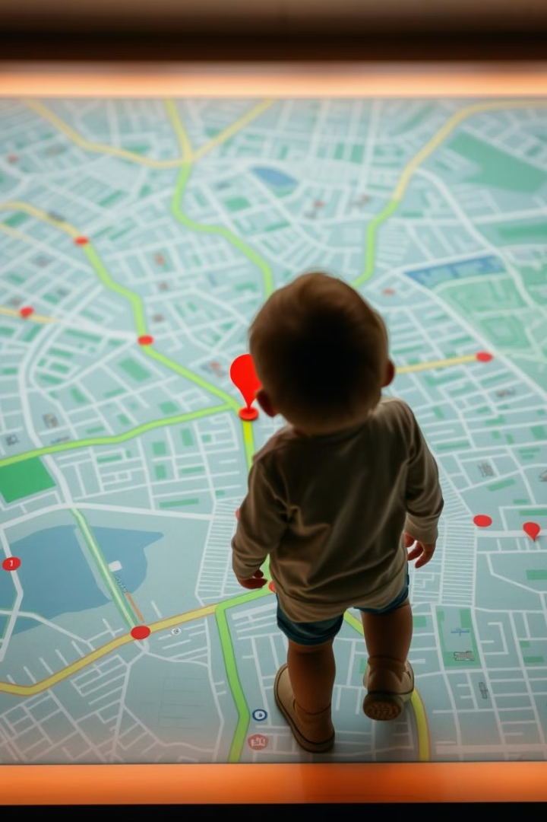
Monitoring Location and Movement
1
Real-Time Tracking
Parents can see their child's location in real-time on a map.
2
Geofencing
Parents can set up virtual boundaries and receive alerts when children enter or leave designated areas.
3
Historical Tracking
Parents can review their child's past locations and movement patterns.

Slide 5
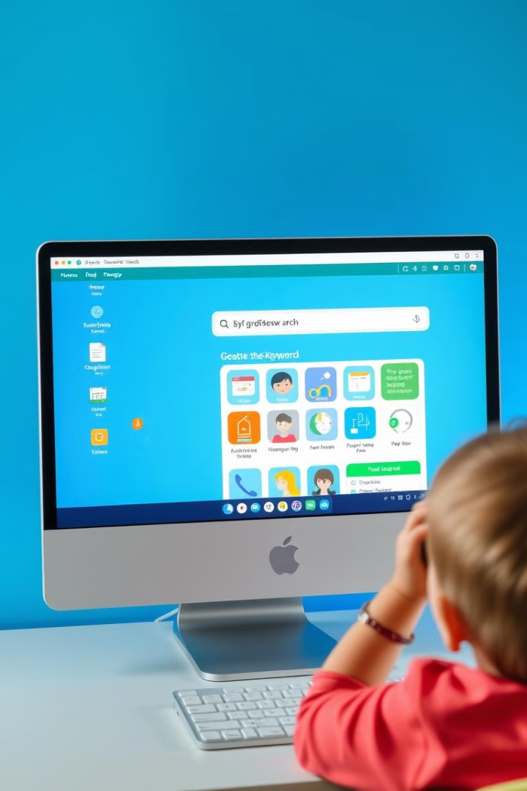



Tracking Online Activity and Browsing History
Content Filtering
Filters block inappropriate websites and content.
Time Limits
Set daily or weekly time limits for internet use.
App Monitoring
Track which apps children are using and for how long.

Slide 6
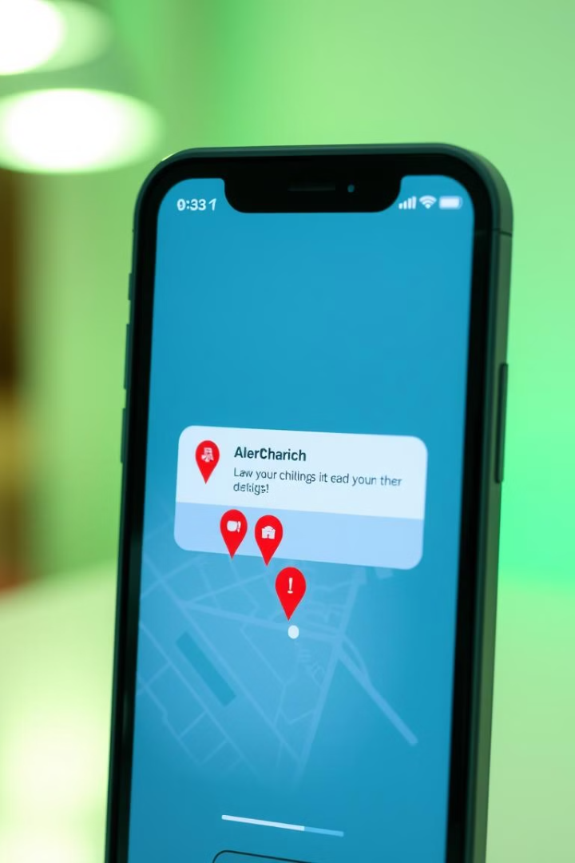
Alerts and Notifications for Parents
Location Alerts
Receive alerts when children arrive at or leave specific locations.
Activity Alerts
Get notified about unusual activity, such as excessive screen time or inappropriate app use.
Emergency SOS
Children can send SOS signals to parents in emergencies.

Slide 7





Balancing Safety and Privacy
Transparency
Limits
Open communication and clear explanations of tracking tools.
Respect children's privacy and avoid excessive monitoring.
Consent
Control
Obtain children's consent (age-appropriately) for tracking tools.
Empower children to understand and manage their digital privacy.

Slide 8

Responsible Use and Ethical Considerations
Respectful Boundaries
Trust and Communication
Use tracking tools responsibly and avoid intruding on children's privacy.
Build trust and communicate openly with children about tracking tools.
Ethical Use
Education
Consider the ethical implications of tracking and use it only for legitimate purposes.
Educate children about online safety and privacy.

